Slide 1
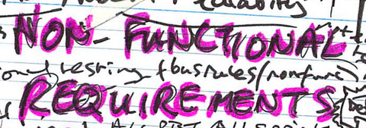
Non Functional Requirements
by:
Dr. Timothy Korson
CPIS 443

Slide 2
Functional Requirement
Functionality that is provided in the system interface to allow a user to achieve their goal
Purchase a book on Amazon.com
There is a way to log on, select a book, enter my credit card number, choose a shipping option, etc.

Slide 3
Non Functional Requirements
Sometimes called
Quality requirements
System requirements
Technical Requirements
System requirements for which there is no user interface
When I use a credit card on Amazon , all transmission or storage of my card must be encrypted

Slide 4
Types of Non-Functional Requirements (Wikipedia)
Accessibility
Audit and control
Availability (see service level agreement)
Backup
Capacity, current and forecast
Certification
Compliance
Configuration management
Dependency on other parties
Deployment
Documentation
Disaster recovery
Efficiency (resource consumption for given load)
Effectiveness (resulting performance in relation to effort)
Emotional factors (like fun or absorbing)
Escrow
Extensibility (adding features, and carry-forward of customizations at next major version upgrade)
Failure management
Legal and licensing issues or patent-infringement-avoidability
Interoperability
Maintainability
Modifiability
Network topology

Slide 5
Types of Non-Functional Requirements (Wikipedia)
Open source
Operability
Performance / response time (performance engineering)
Platform compatibility
Price
Privacy
Portability
Quality (e.g. faults discovered, faults delivered, fault removal efficacy)
Recovery / recoverability (e.g. mean time to recovery - MTTR)
Reliability (e.g. mean time between failures - MTBF)
Resilience
Resource constraints (processor speed, memory, disk space, network bandwidth etc)
Response time
Robustness
Scalability (horizontal, vertical)
Security
Software, tools, standards etc. Compatibility
Stability
Safety
Supportability
Testability
Usability by target user community

Slide 6
Categories of Non-Functional Requirements
Legal and regulatory
Accessibility
Certification
Compliance
Escrow
Legal and licensing issues or patent-infringement-avoidability
Audit and control
Usability
Documentation
Emotional factors (like fun or absorbing)
Operability
Privacy
Safety
Usability by target user community
Capacity
Efficiency (resource consumption for given load)
Scalability (horizontal, vertical)
Deployment and development environment
Network topology
Interoperability
Open source
Platform compatibility
Software, tools, standards etc.
Performance
Response time
performance engineering

Slide 7
Categories of Non-Functional Requirements
Architecture
Maintainability
Modifiability
Extensibility (adding features, and carry-forward of customizations at next major version upgrade)
Portability
Resource constraints (processor speed, memory, disk space, network bandwidth etc)
Supportability
Testability
Security
Encryption
Firewalls
Input sanitation
Reliability
Availability (see service level agreement)
Backup
Disaster recovery
Failure management
Recovery / recoverability (e.g. mean time to recovery - MTTR)
Reliability (e.g. mean time between failures - MTBF)
Resilience
Robustness
Quality (e.g. faults discovered, faults delivered, fault removal efficacy)
Stability
Concurrence
Race conditions

Slide 8
Legal and regulatory
Accessibility
Certification
Compliance
Escrow
Legal and licensing issues or patent-infringement-avoidability
Audit and control

Slide 9
Usability
Documentation
Emotional factors (like fun or absorbing)
Operability
Privacy
Safety
Usability by target user community

Slide 10
Deployment and Development Environment
Network topology
Interoperability
Open source
Platform compatibility
Operational environment
Software, tools, standards etc.
Portability
Installation Testing, deployment scripts

Slide 11
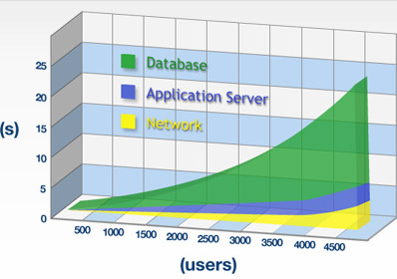
Capacity
Efficiency (resource consumption for given load)
Scalability (horizontal, vertical)

Slide 12
Performance
Response time

Slide 13
Some “Performance Testing” Definitions
The following definitions are attributed to Ross Collard
Load Test: a measurement of performance under heavy load (peak or worst-case)
Stress Test: pushes the load beyond specified or expected limits
Response Time Test: measures how long to complete a group of tasks
Throughput Test: measure the amount of data through the system under load
Capacity Test: measure the ability of a system to support additional workload without degrading performance unacceptably.

Slide 14
Some “Performance Testing” Definitions
Duration Testing: places a load on system for an extended time looking for degradation of service
Hot Spot Test: stressing a particular sub-system looking for a weak point
Spike (Bounce) Test: injecting a very high load for a short time to see how system handles a sudden increase in load
Breakpoint Test: increase load up to breaking point to determine the break-down characteristics
Rendezvous Test: spike testing where many of the same event occur simultaneously (i.e. everyone logging into email at the same time.)

Slide 15
Architecture
Maintainability
Modifiability
Extensibility (adding features, and carry-forward of customizations at next major version upgrade)
Resource constraints (processor speed, memory, disk space, network bandwidth etc)
Supportability
Testability

Slide 16
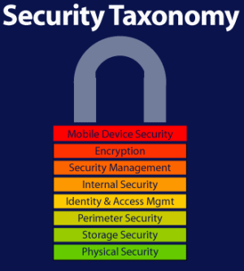
Security
Encryption
Firewalls
Input sanitation
Cross site scripting
SQL injection

Slide 17
Reliability
Availability (see service level agreement)
Backup
Disaster recovery
Failure management
Recovery / recoverability (e.g. mean time to recovery)
Reliability (e.g. mean time between failures - MTBF)
Resilience
Robustness
Quality (e.g. faults discovered, faults delivered, fault removal efficacy)
Stability

